Slide 1

UNH SEDS
Reilly Webb
Nick Clegg
KevIn Bucher

Slide 2
Project Overview and Introduction
Students for the Exploration and Development of Space (SEDS) is a new club and senior design project at UNH.
The goal is to successfully launch and safely recover a two-stage, solid-propellant rocket to the highest possible altitude as part of a collegiate competition (USRC)
This project will include designing and manufacturing a static test fire rig to collect experimental thrust data for the engines.
We will also be designing and manufacturing our own launch pad

Slide 3
Explicit project statement (goals & objectives, boundaries, and deliverables)
The goal is maximum altitude with a minimum apogee of at least 3,000 feet
The rocket should be easy to manufacture and assemble, so that many iterations can be tested before the final design.
The rocket must be recoverable and reusable
Nothing can fall faster than 5 m/s
The total combined impulse of all engines must not exceed 640.0 Newton-seconds. Therefore each stage contains a 320 N-s engine.

Slide 4

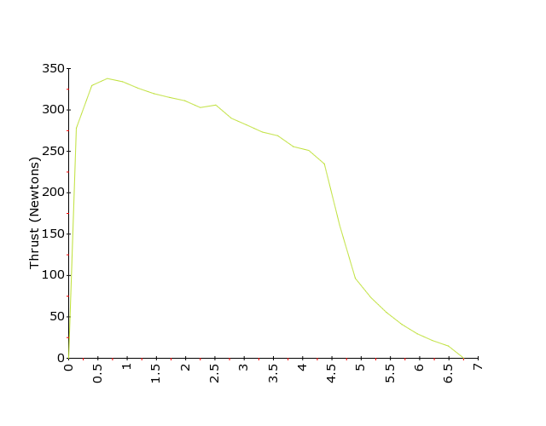
Static Test Fire
A Static Test fire rig is used for the purpose of obtaining thrust profiles.
Thrust profiles are very useful for multistage rockets, as it gives us a good estimate as when to separate the first stage engine
A Thrust profile allows the team to compute impulse, which it vital since we are constrained by 640 Newton-seconds total impulse.

Slide 5
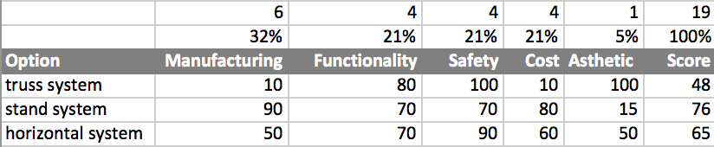
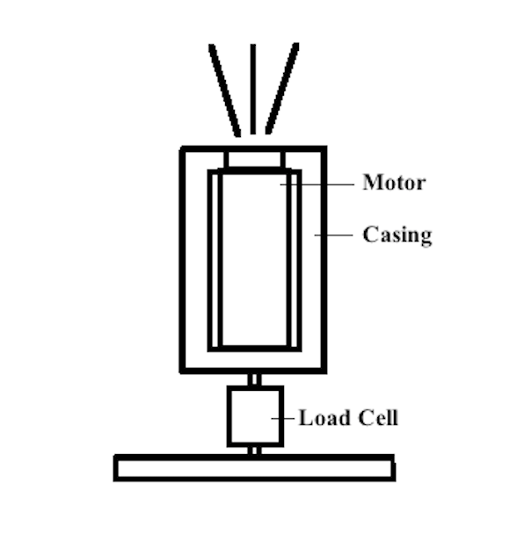
Decision Matrices

Slide 6
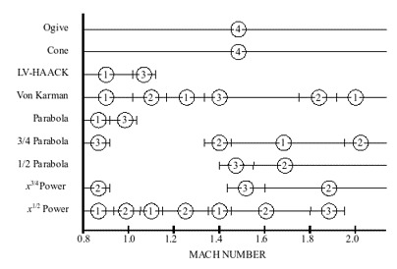
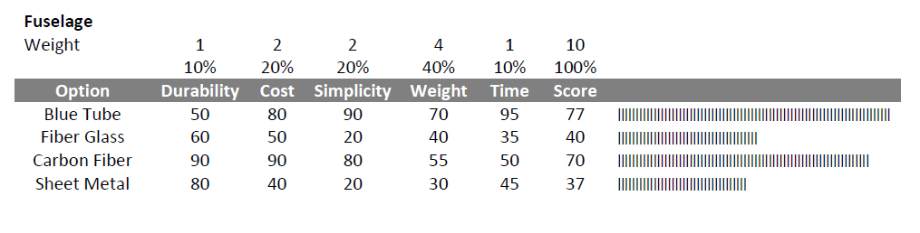
AERO DECISION MATRICES/FINAL DESIGN

Slide 7
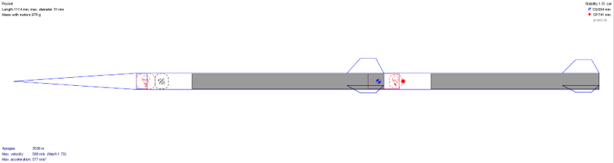
Aero/Rocket Body
High Thrust to Weight Ratio
Minimize overall aerodynamic drag
Maintain a reasonable passive stability.
A rocket is deemed statically stable if its center of pressure (CP) is aft of its center of gravity (CG) by at least one diameter. This is adjusted primarily by fin design.
Make sure the rocket can withstand landing impact at 5 m/s

Slide 8
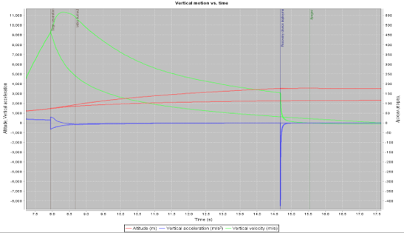
Analyses performed that drove the decision process
The lower the diameter, the lower the drag forces on the rocket. This allowed us to select for the lowest possible diameter engine, then make the fuselage inner diameter match the diameter of the engine.
Aerodynamic force components of interest are normal force and drag. These were difficult to determine with hand calculations so we used simulations (OpenRocket) that utilized Runge-Kutta and numerical integration.
Notes:
Larger surface area at the aft end of the rocket brings the location of the center of pressure back. The center of gravity can be calculated fairly easily once relative sizes are known. The center of pressure is a bit more difficult. Ours is estimated using the barrowman equations.

Slide 9
Project schedule and current status
The initial design phase of the 1st stage rocket is complete
Parts have just been received and Manufacturing is getting underway
The goal is to launch the 1st stage rocket by the end of the semester
Multistage rocket will go into design/production next semester
Final Launch date for competition is October 2018

Slide 10
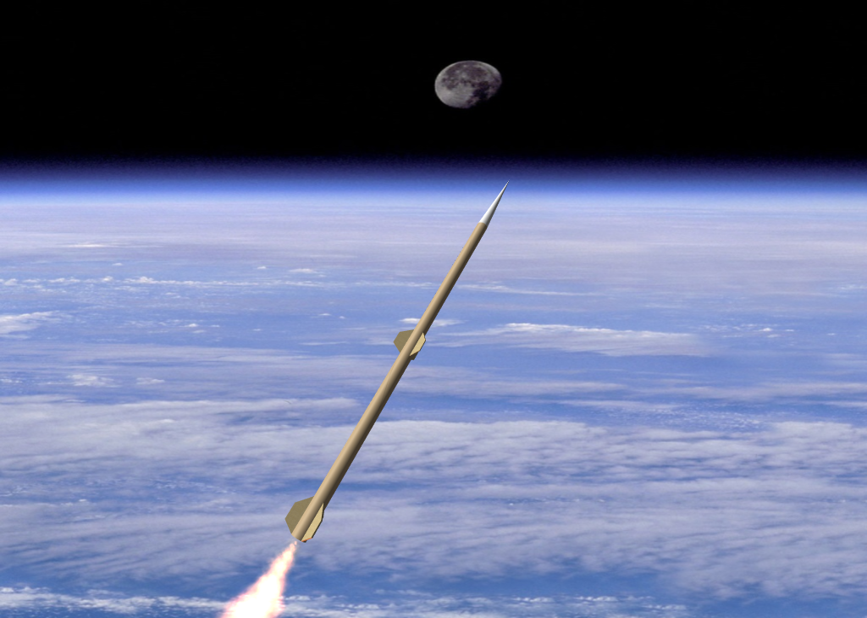
Past and potential obstacle/challenges
Discovering the best way to manufacture components of the rocket, static Test Fire and Launch pad
Use of machine shop
Controlling group size
Optimal parachute deployment

